Slide 1

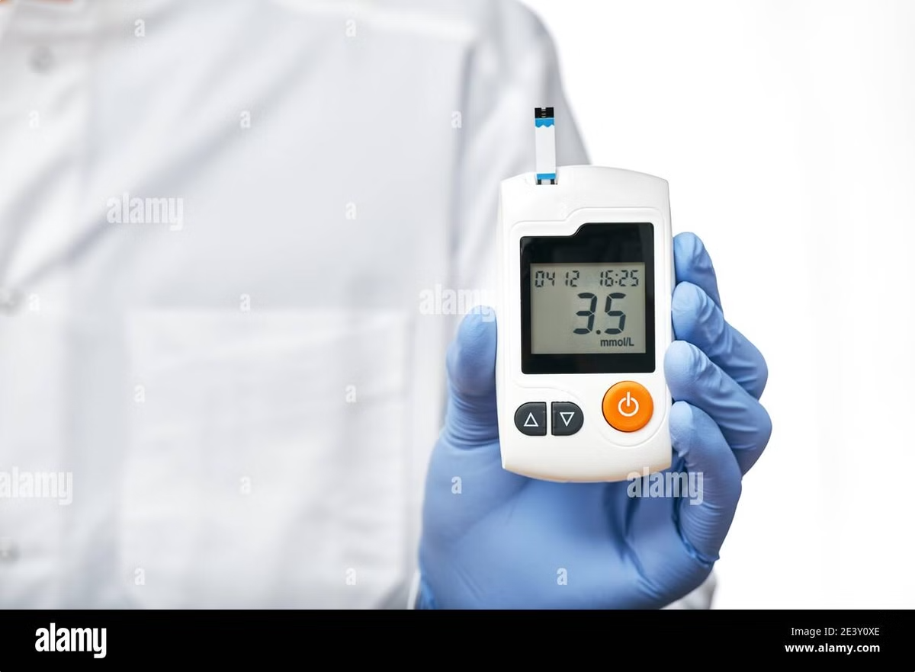
Diabetes Prediction using Machine Learning
Machine learning can analyze a patient's medical data to predict the likelihood of developing diabetes. This can help healthcare professionals identify individuals at risk and intervene early to prevent complications.

Slide 2
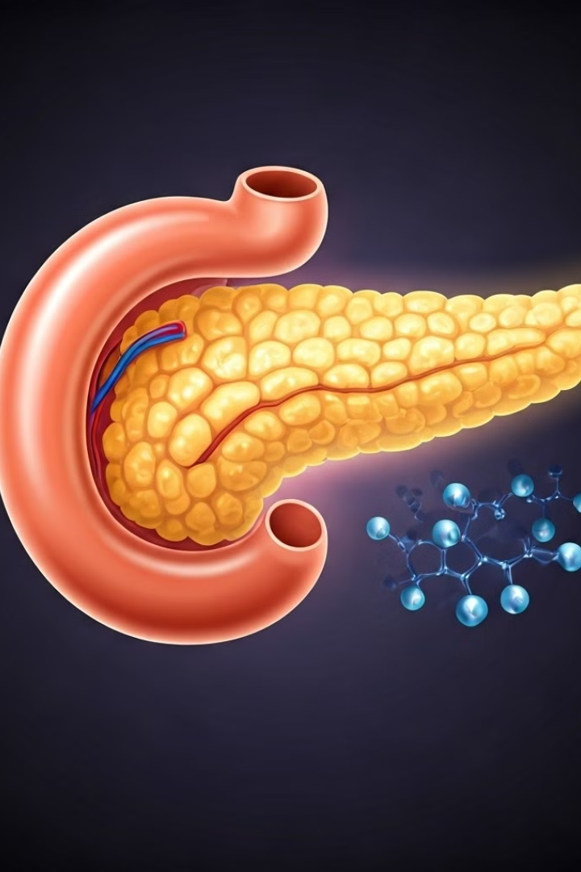
Introduction to Diabetes
Chronic Disease
Blood Sugar Regulation
Diabetes is a chronic condition where the body doesn't produce enough insulin or can't properly use the insulin it produces.
Insulin is a hormone that regulates blood sugar levels, allowing the body to use glucose for energy.
Types of Diabetes
There are different types of diabetes, including type 1, type 2, and gestational diabetes.

Slide 3


Machine Learning Fundamentals
1
Algorithms
2
Training Data
Machine learning algorithms use data to learn patterns and make predictions.
Algorithms are trained on a dataset of labeled examples to learn the relationship between input features and target variables.
3
Model Evaluation
The performance of a trained model is evaluated using metrics like accuracy, precision, and recall.

Slide 4

Data Collection and Preprocessing
1
Data Sources
Data can be collected from various sources, such as electronic health records, patient surveys, and medical databases.
2
Data Cleaning
Missing values, outliers, and inconsistencies need to be addressed to ensure data quality.
3
Data Transformation
Data may need to be scaled, normalized, or encoded to prepare it for machine learning algorithms.

Slide 5
Feature Engineering and Selection
Feature Engineering
Feature Selection
Creating new features from existing data can improve model performance.
Selecting the most relevant features for the model can reduce complexity and improve accuracy.
For example, combining age and body mass index to create a new feature called BMI category.
Techniques include removing redundant features, identifying highly correlated features, and ranking features by their importance.

Slide 6
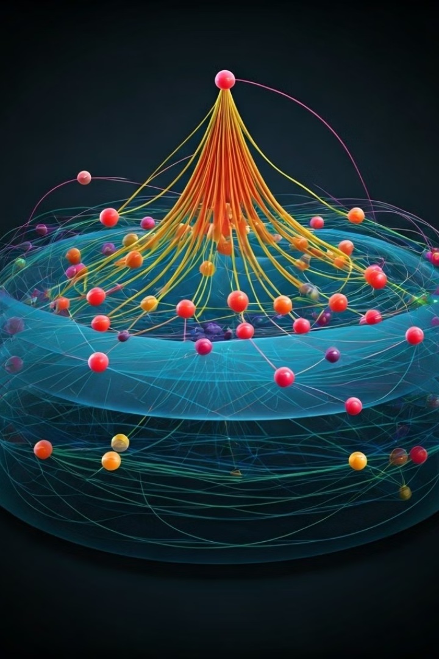
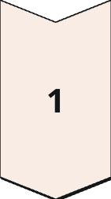
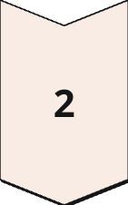
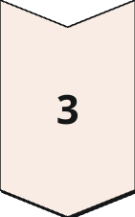
Model Selection and Training
Model Selection
Choosing the appropriate machine learning algorithm depends on the nature of the data and the prediction task.
Model Training
The selected model is trained on the prepared data to learn the underlying patterns and relationships.
Hyperparameter Tuning
Optimizing model parameters, such as learning rate and regularization strength, to enhance performance.

Slide 7
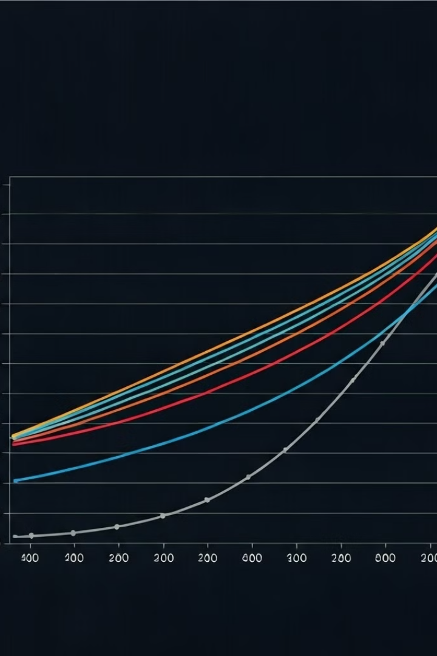
Model Evaluation and Validation
Metric
Description
Accuracy
Proportion of correctly predicted instances.
Precision
Fraction of true positives among predicted positives.
Recall
Fraction of true positives among actual positives.

Slide 8




Deployment and Real-world Applications
Early Detection
Predictive models can identify individuals at high risk of developing diabetes, enabling early intervention and prevention.
Risk Assessment
Models can assess individual risk factors and provide personalized recommendations for lifestyle modifications and treatment.
Treatment Optimization
Models can assist in determining optimal treatment strategies based on patient characteristics and disease progression.

